Slide 1
Daily Scrum
08/05
Hyung Ryuk Kim Java A-4 SK Didimdol 4th hyungryug@gmail.com

Slide 2
Task List
Assigned Task | Progress
UI Design: 검색결과, 상세정보 | 100%
Layout 구현 : 검색결과, 상세정보 | 0%

Slide 3
Yesterday’s Task
Today’s Task
Technical Issue

Slide 4
1. Yesterday’s Task
What I did?
SourceTree VCS설치

Slide 5
1. Yesterday’s Task
How I did?
SourceTree VCS설치
SourceTree VCS 설치
Branch 나누기, pull, commit, push 작동 여부 확인

Slide 6
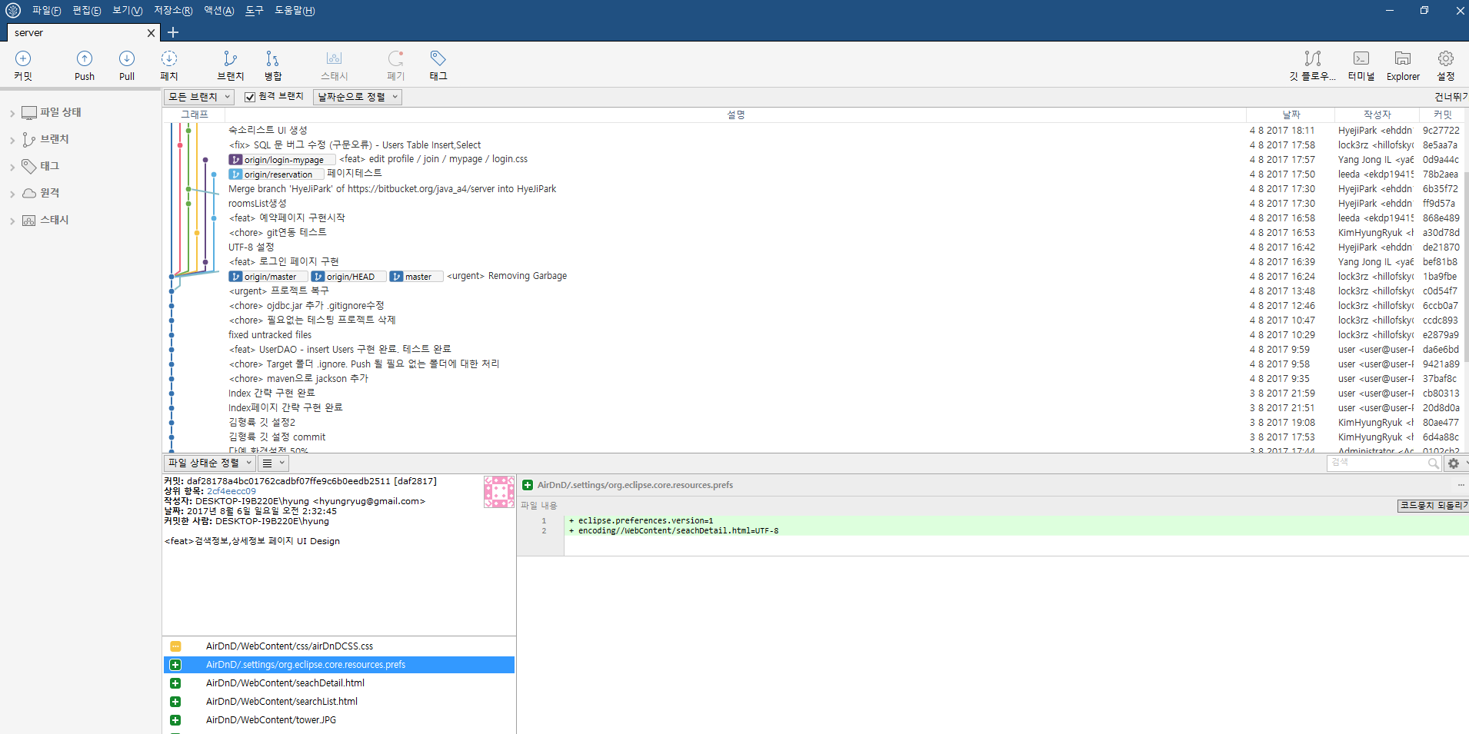
1. Yesterday’s Task
Result (SourceTree VCS)

Slide 7
Yesterday’s Task
Today’s Task
Technical Issue

Slide 8
2. Today’s Task
ToDo

Slide 9
Yesterday’s Task
Today’s Task
Technical Issue

Slide 10
3. Technical Issue
Issue

Slide 11
END

